Slide 1
Comparative Evaluation of Machine Learning Models for Phishing Detection
Supervised By
Dr.Gurpreet Singh
Prabhjot Singh (2210990658) Prathamvir Singh Luthra (2210990677)
Priyanshu Gupta (2210990687) Puneet Chauhan(2210990691)
Department of Computer Science and Engineering, Chitkara University, Punjab

Slide 2
Introduction
Phishing attacks have become one of the most widespread cybersecurity threats, causing significant financial and data losses worldwide.
Machine learning techniques are increasingly being adopted for phishing detection due to their ability to identify malicious patterns and suspicious website behaviors automatically.
Different machine learning models such as Decision Trees, Random Forest, Support Vector Machines, and Neural Networks vary in terms of detection accuracy, speed, and reliability.
A comparative evaluation of these models is essential to determine which algorithms provide the best performance for real-time phishing detection systems.
This research paper aims to analyze and compare multiple machine learning models based on evaluation metrics such as accuracy, precision, recall, F1-score, and computational efficiency.

Slide 3
Objective
To study the impact of phishing attacks and the importance of intelligent detection systems in modern cybersecurity.
To implement and evaluate different machine learning models for identifying phishing websites and malicious online activities.
To compare the performance of various machine learning algorithms using evaluation metrics such as accuracy, precision, recall, and F1-score.
To identify the strengths and limitations of each machine learning model in terms of detection efficiency, speed, and reliability.
To determine the most effective machine learning approach for improving phishing detection and enhancing online security systems.

Slide 4
Problem Statement
The rapid increase in phishing attacks has made traditional rule-based and blacklist-based detection methods insufficient for identifying newly emerging phishing websites.
Different machine learning models are being used for phishing detection, but their performance varies significantly depending on the dataset, feature selection, and evaluation criteria.
There is a lack of comprehensive comparative studies that analyze the effectiveness, accuracy, and efficiency of multiple machine learning algorithms under similar conditions.
Many existing phishing detection systems suffer from high false positive and false negative rates, reducing their reliability in real-world cybersecurity applications.
This research aims to address these challenges by conducting a comparative evaluation of various machine learning models to identify the most accurate and efficient approach for phishing detection.

Slide 5
Methodology
Data Collection and Preprocessing: Phishing and legitimate website datasets were collected and cleaned to remove missing or irrelevant data before analysis.
Feature Extraction and Selection: Important features such as URL length, domain information, and security-related attributes were extracted for phishing detection.
Implementation of Machine Learning Models: Multiple machine learning algorithms including Decision Tree, Naïve Bayes, SVM, KNN, Neural Network, and Random Forest were implemented and trained.
Performance Evaluation and Comparison: The models were evaluated and compared using metrics such as accuracy, precision, recall, F1-score, efficiency, and scalability.

Slide 6
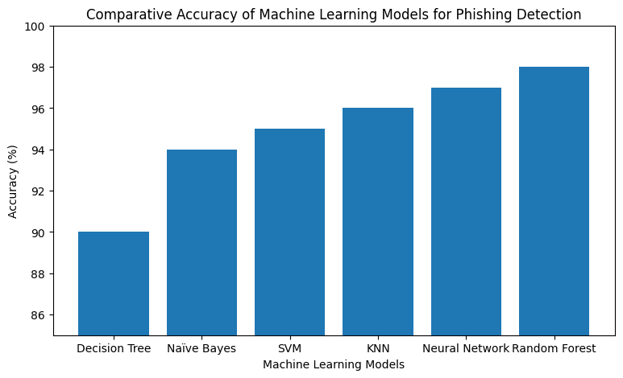
Class Distribution

Slide 7
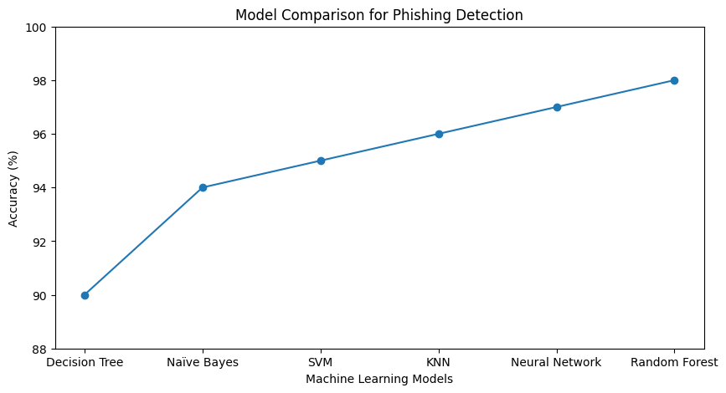
Model comparison

Slide 8
Results & Discussion
Model Performance
Random Forest achieved the highest accuracy (98%), followed by Neural Network (97%), KNN (96%), SVM (95%), Naïve Bayes (94%), and Decision Tree (90%). Advanced models performed better in detecting phishing websites.
Efficiency and Scalability
Naïve Bayes and Decision Tree were faster and required fewer resources, while Random Forest and Neural Networks handled large datasets more effectively with higher accuracy. KNN and SVM provided balanced performance but required more computation for large data.
Key Observations
Random Forest was the most accurate and reliable model.
Neural Networks effectively detected complex phishing patterns.
Decision Tree showed lower performance due to overfitting.
Feature selection and dataset quality greatly affected model accuracy.
Machine learning improved phishing detection and cybersecurity efficiency.

Slide 9
Conclusion
The study demonstrated that machine learning techniques are highly effective for detecting phishing websites and improving cybersecurity systems.
Among all evaluated models, Random Forest achieved the highest accuracy and reliability for phishing detection.
Advanced models such as Neural Networks and Random Forest performed better in identifying complex phishing patterns compared to traditional algorithms.
The research confirms that selecting appropriate features and machine learning models can significantly enhance the accuracy and efficiency of phishing detection systems.

Slide 10
Thank You
3

